Slide 1

Ensemble Methods
Module 6CM521: Frontiers in AI and Data Science
Ioannis Tsioulis (MC)
Slides acknowledgements:
Dr Aaisha Makkar

Slide 2
Outlook
Random Forest (RF):
  Bagging based RF
  Boosting based RF
K-NN

Slide 3
Classification Tree
Disadvantages of the Tree-Structured Approach
Do not predict very accurately compared to other kinds of machine learning models, which is due to the greedy nature of the tree construction algorithms, e.g information gain or Gini index, which introduce overfitting problems very easily.
Trees are unstable
  Small changes to the input data can have large effects on the structure of the tree due to the hierarchical nature of the tree-growing process.
Solution: bagging and boosting.

Slide 4
Model Averaging
Previously, we focused on machine learning procedures that produce a single set of results:
  A regression equation, with one set of regression coefficients or smoothing parameters.
  A classification regression tree with one set of leaf nodes.
Model selection is often required: a measure of fit associated with each candidate model.
Here, the discussion shifts to machine learning building on many sets of outputs that are aggregated to produce results.

Slide 5
Model Averaging (cont’d)
The aggregating procedure makes multiple tree growing path over the data.
On each path, inputs X (divided by bagging process) are linked with outputs Y just.
However, of interest now is the collection of all the results from these different trees for aggregating votes.
Aggregated results have several important benefits.

Slide 6
Model Averaging (cont’d)
Averaging over a collection of fitted values can help to avoid overfitting.
It tends to cancel out the uncommon features of the data captured by a specific model. Therefore, the aggregated results are more stable.
A large number of fitting attempts can produce very flexible fitting functions.
Putting the averaging and the flexible fitting functions together has the potential to break the bias-variance tradeoff.

Slide 7
Model Averaging (cont’d)
Ideally, one would have two random samples from the same population: a training dataset and a test dataset. The fit measure from the test data would be a better indicator of how accurate the classification is.
Often there is only a single dataset. The data are split up into several randomly chosen, non-overlapping, partitions of about the same size. With ten partitions, each would be a part of the training data in learning, and serve as the test data in one analysis.
The model selection is based on choosing the one with smallest cross-validation prediction error.

Slide 8
Outlook
Random Forest (RF):
  Bagging based RF
  Boosting based RF
K-NN

Slide 9
Bagging: Bootstrap Aggregating
There is a very powerful idea in the use of subsamples of the data and in averaging over subsamples through bootstrapping.
Bagging exploits that idea to address the overfitting issue in a more fundamental manner.
It was invented by Leo Breiman, who called it "bootstrap aggregating" or simply "bagging.“
In a classification tree, bagging takes a majority vote from classifiers trained on bootstrap samples of the training data.
Introduction to bootstrap method:
https://towardsdatascience.com/an-introduction-to-the-bootstrap-method-58bcb51b4d60

Slide 10
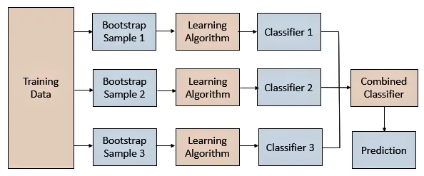
Bagging-based Averaging Learning

Slide 11

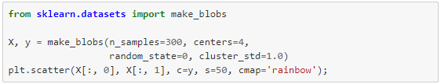
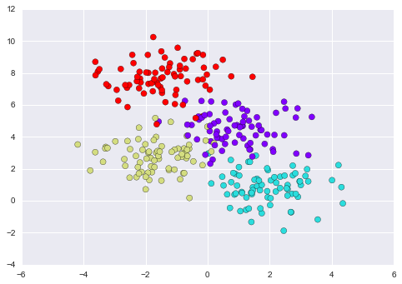
Example

Slide 12
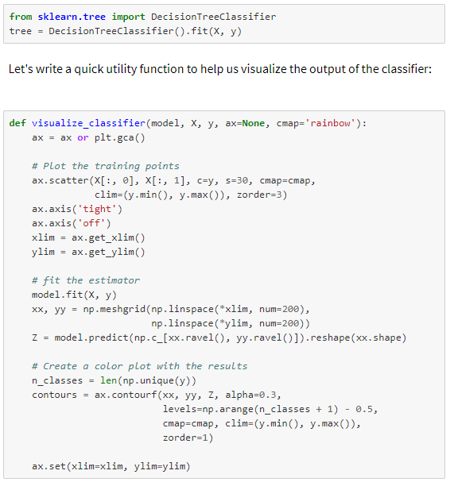
Example

Slide 13
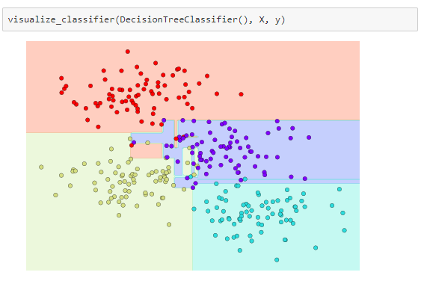
Example

Slide 14
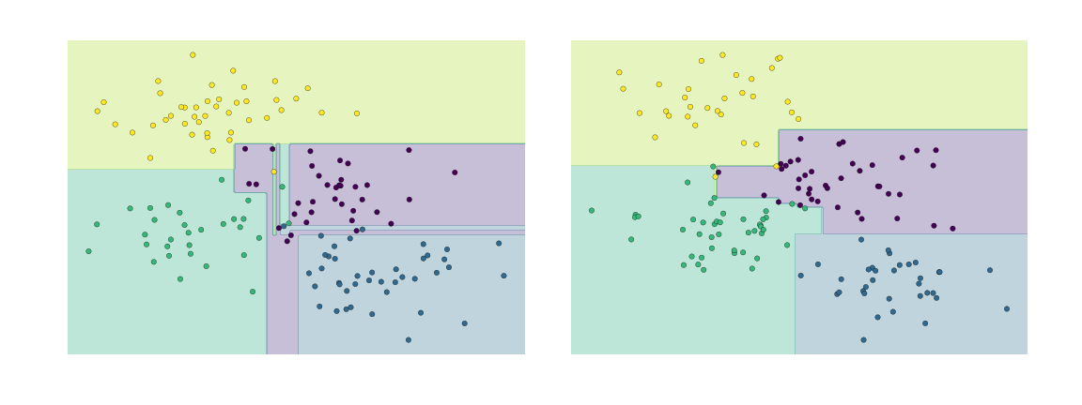
Example
Decision trees and over-fitting: another way to see this over-fitting is to look at models trained on different subsets of the data—for example, in this figure we train two different trees, each on half of the original data:

Slide 15
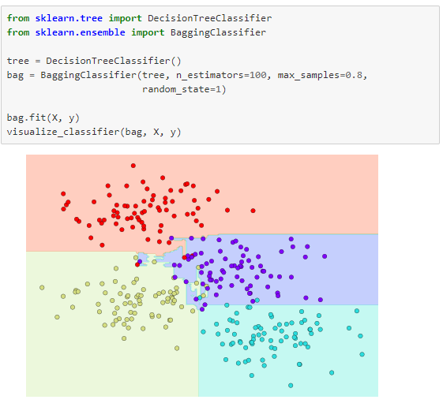
Example
Notes:
In this example, we have randomized the data by fitting each estimator with a random subset of 80% of the training points.

Slide 16
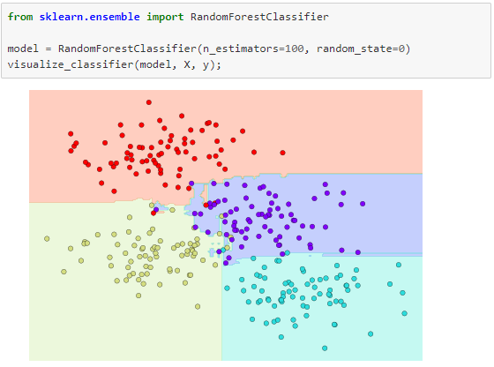
Example
Notes:
In Scikit-Learn, such an optimized ensemble of randomized decision trees is implemented in the RandomForestClassifier estimator, which takes care of all the randomization automatically. All you need to do is select a number of estimators, and it will very quickly (in parallel, if desired) fit the ensemble of trees:

Slide 17
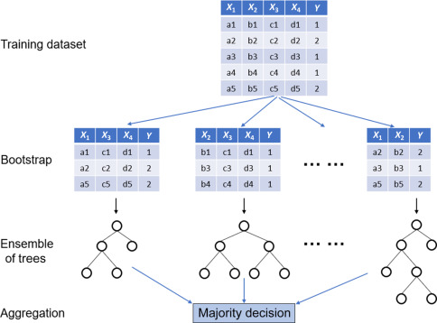
Random Forests with bootstrap

Slide 18
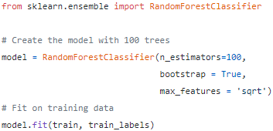
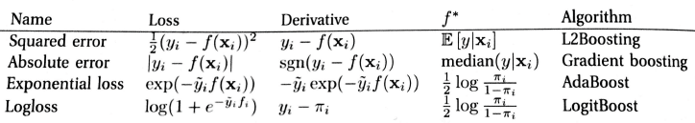
Sklearn Python
Numbers of trees
Default is true means sampling
Here are some commonly used loss functions, gradients, population minimizers, and algorithms to minimize the loss:

Slide 19
Outlook
Random Forest (RF):
  Bagging based RF
  Boosting based RF
K-NN

Slide 20
Boosting: Bootstrap Sampling
Boosting, like bagging, is another general approach for improving prediction results for various machine learning methods.
It is also particularly well suited to decision trees.
Rather than resampling the data, however, boosting weights on some examples during learning.
Specifically, in boosting the trees are grown sequentially: each tree is grown using information from previously grown trees.

Slide 21
Boosting (cont.)
Here are some commonly used loss functions, gradients, population minimizers, and algorithms to minimize the loss:

Slide 22
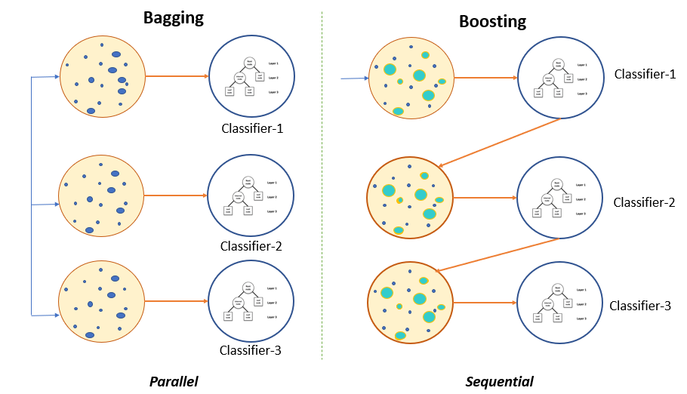
Bagging vs Boosting

Slide 23
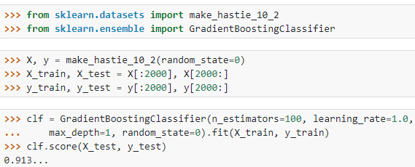
Boosting (cont.)
Boosting is remarkably resistant to overfitting, and it is fast and simple.
In fact, it can often continue to improve even when the training error has gone to zero.
It improves the performance of many kinds of machine learning algorithms.
Boosting does not work when:
  Not enough data, base learner is too weak or too strong, and/or susceptible to noisy data.

Slide 24
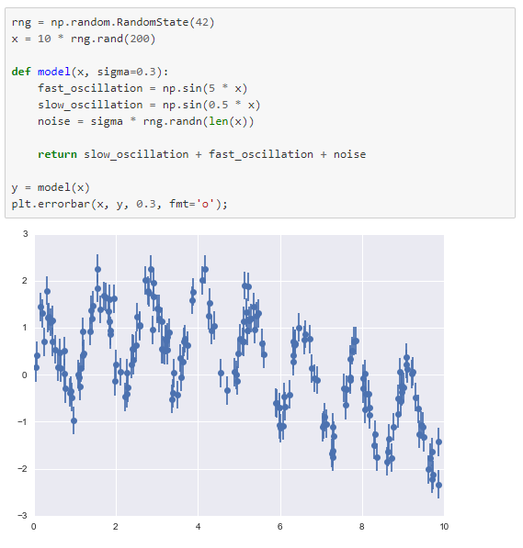
Random Forest Regression
Non-linear regression problem

Slide 25
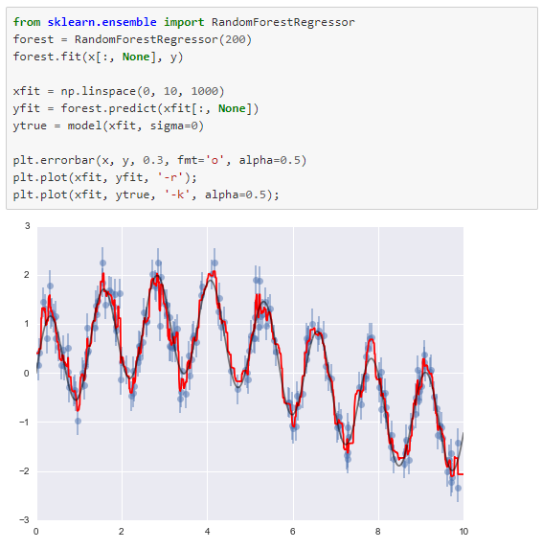
Random Forest Regression

Slide 26
Outlook
Random Forest (RF):
  Bagging based RF
  Boosting based RF
K-NN

Slide 27
K-NN: An Instance-Based Learning process
Idea:
  Similar examples have similar label.
  Classify new examples like similar training examples.
Algorithm:
  Given some new example x for which we need to predict its class y
  Find most similar training examples
  Classify x “like” these most similar examples
Questions:
  How to determine similarity?
  How many similar training examples to consider?
  How to resolve inconsistencies among the training examples?
Notes:
Similar inputs map to similar outputs
If not true => learning is impossible
If true => learning reduces to defining “similar”

Slide 28
k-NN Approach
The simplest, most used instance-based learning algorithm is the k-NN algorithm
k-NN assumes that all instances are points in some n-dimensional space and defines neighbors in terms of distance (usually Euclidean in R-space)
k is the number of neighbors considered

Slide 29
1-Nearest Neighbor
One of the simplest of all machine learning classifiers
Simple idea: label a new point the same as the closest known point
Label it red.

Slide 30
1-Nearest Neighbor
A type of instance-based learning
  Also known as “memory-based” learning
Forms a Voronoi tessellation of the instance space

Slide 31
Distance Metrics
Different metrics can change the decision surface
Standard Euclidean distance metric:
  Two-dimensional: Dist(a,b) = sqrt((a₁ – b₁)² + (a₂ – b₂)²)
  Multivariate: Dist(a,b) = sqrt(∑ (a_{i} – b_{i})²)
Dist(a,b) =(a₁ – b₁)² + (a₂ – b₂)²
Dist(a,b) =(a₁ – b₁)² + (3a₂ – 3b₂)²

Slide 32
1-NN’s Aspects as an
Instance-Based Learner:
A distance metric
  Euclidean
  When different units are used for each dimension
    → normalize each dimension by standard deviation
  For discrete data, can use hamming distance
    → D(x1,x2) =number of features on which x1 and x2 differ
  Others (e.g., normal, cosine)
How many nearby neighbors to look at?
  One
How to fit with the local points?
  Just predict the same output as the nearest neighbor.
Adapted from “Instance-Based Learning”
lecture slides by Andrew Moore, CMU.

Slide 33
k – Nearest Neighbor
Generalizes 1-NN to smooth away noise in the labels
A new point is now assigned the most frequent label of its k nearest neighbors
Label it red, when k = 3
Label it blue, when k = 7

Slide 34
Selecting the Number of Neighbors
Increase k:
  Makes KNN less sensitive to noise
Decrease k:
  Allows capturing finer structure of space
➔Pick k not too large, but not too small (depends on data)

Slide 35
Curse-of-Dimensionality
Prediction accuracy can quickly degrade when number of attributes grows.
  Irrelevant attributes easily “swamp” information from relevant attributes
  When many irrelevant attributes, similarity/distance measure becomes less reliable
Remedy
  Try to remove irrelevant attributes in pre-processing step
  Weight attributes differently
  Increase k (but not too much)
Notes:
Prediction accuracy can quickly degrade when number of attributes grows.
Imagine attribute vector (y,r1,r2,r3,…,rN),
first feature always tells the label
r1,..rn take random binary values.
What is the probability that nearest neighbor has same label? P(y=yNN)
Similarity measure is number of mismatches.
Assume we have only two training examples, one for each label. Both training examples have distance N+1 (all bits different)
(-1,+1,-1,+1,-1,+1,…,-1)
(+1,-1,+1,-1,+1,-1,…,+1)
If N=0, then P(y=yNN)=1
If N=2, then P(y=yNN)=3/4
→ need both random attributes to match the wrong examples
(4 outcomes on random attributes, and only one leads to a mistake)
If N=4, then P(y=yNN)=11/16
→ need three random attributes to match the wrong examples
(16 outcomes on random attributes, and 5 lead to a mistake)
If N=100, then P(y=yNN) almost 1/2
→ need N/2+1 random attributes to match the wrong examples
For every random attribute, we need exponentially more training examples.

Slide 36
Advantages and Disadvantages of KNN
Need distance/similarity measure and attributes that “match” target function.
For large training sets,
→ Must make a pass through the entire dataset for each classification. This can be prohibitive for large data sets.
Prediction accuracy can quickly degrade when number of attributes grows.
Simple to implement algorithm;
Requires little tuning;
Often performs quite weel!
(Try it first on a new learning problem).
Notes:
Need similarity measure and attributes that “match” target function
predicting a person’s height may depend on different attributes than predicting their IQ

Slide 37

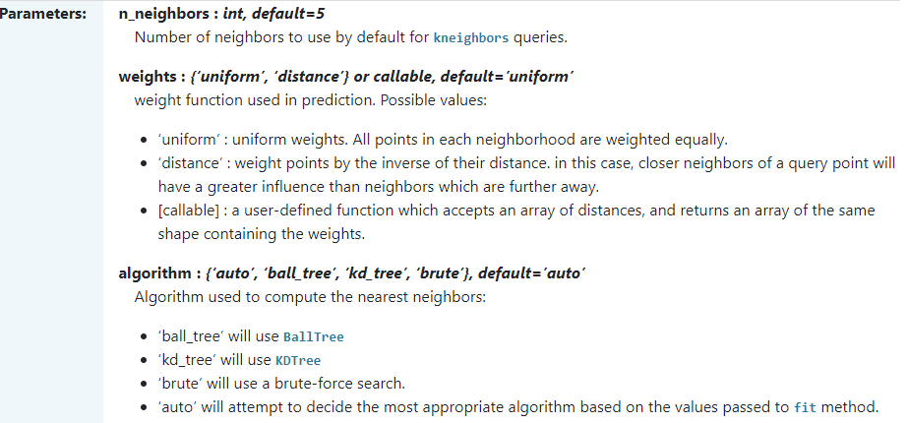
K-NN in Python
https://scikit-learn.org/stable/modules/generated/sklearn.neighbors.KNeighborsClassifier.html

Slide 38
How do you decide the number of neighbours in KNN?
Research has shown that no optimal number of neighbours suits all kind of data sets. Each dataset has it's own requirements. In the case of a small number of neighbours, the noise will have a higher influence on the result, and a large number of neighbours make it computationally expensive.
Data scientists choose as an odd number if the number of classes is even
You can also try Elbow method here.

Slide 39
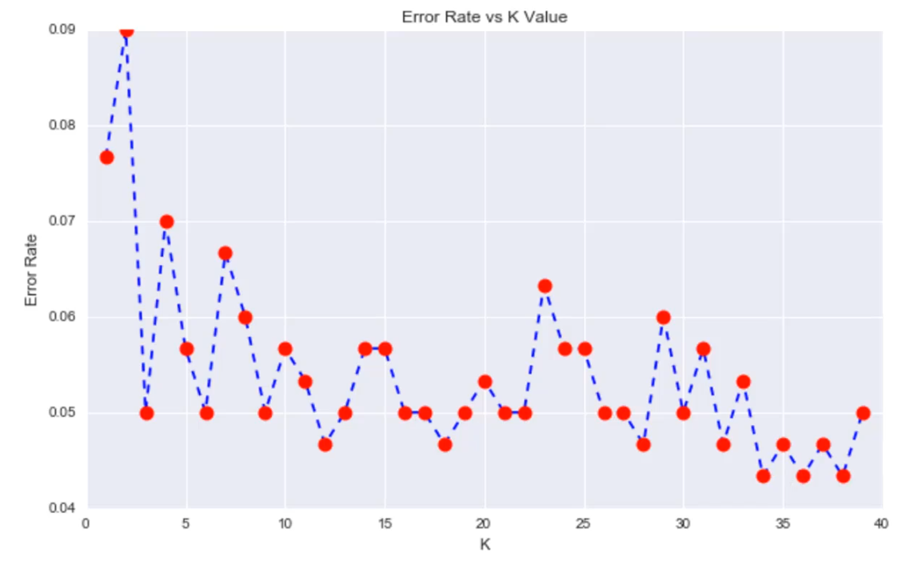
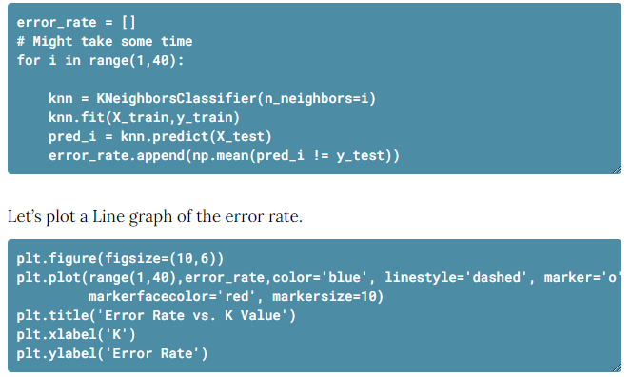
Elbow method
22

Slide 40
Summary
This section contained:
1. A brief introduction to the concept of random forest – an ensemble of randomized decision trees.
2. K-NN algorithm
Lab: Go through a K-NN practice example
Next week:
Unsupervised learning e.g. K-mean to solve clustering problem

Slide 41
Online reference
https://www.datacamp.com/community/tutorials/k-nearest-neighbor-classification-scikit-learnn

